Slide 1
CSE 842 NLP PyTorch Practical Class
Chen Zheng, Parisa Kordjamshidi
{zhengc12, kordjams}@msu.edu
Michigan State University
Computer Science and Engineering Department

Slide 2
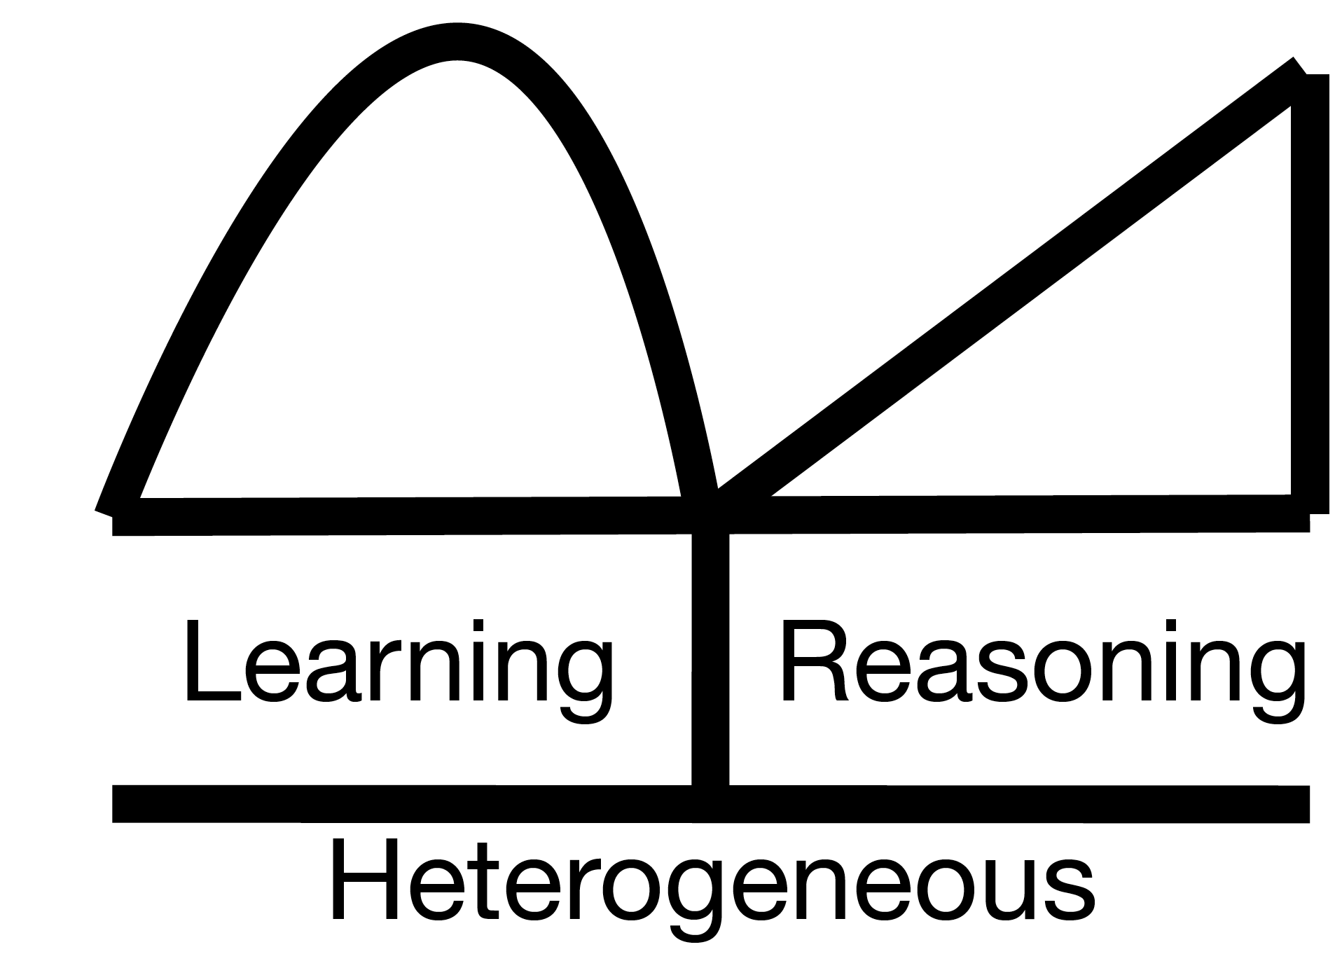
CSE 842 NLP PyTorch Practical Class
Warm Up (Linear Regression)
Multi-Layer Perceptron (MLP) on Sentiment Analysis
Convolutional Neural Network (CNN) on Sentiment Analysis (optional)
Transformer Architecture on Reading Comprehension
Recurrent Neural Network (RNN) on Sequence Tagging
Recommendation: AllenNLP Library (optional)

Slide 3
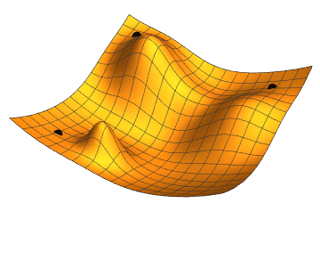
Warm Up (Linear Regression)
Task 1:
Input: Randomly generating 5 (x, y) data points from the Ground-Truth Weight.
Weight w: 1-D tensor w
Loss function: Mean Squared Error.
Compute the derivative.
Find the weight w that minimizes Mean Squared Error.
Task 2:
Input: Randomly generating 100 (x, y) data points.
Weight w: 5-D tensor [w1, w2, w3, w4, w5]
Loss function: Mean Squared Error.
Compute the derivative.
Find the weights [w1, w2, w3, w4, w5] that minimizes Mean Squared Error.

Slide 4
Warm Up (Linear Regression )
Task 2:
Input: Randomly generating 100 (x, y) data points from the Ground-Truth Weight.
Learning Weight w: 5-D tensor [w1, w2, w3, w4, w5].
Loss function: Mean Squared Error.
Gradient Descent Optimizer.
Find the weights [w1, w2, w3, w4, w5] that minimize Mean Squared Error.
Task 3:
Input: Natural Language Processing: (sentence, positive/negative) data points.
Weight W: high dimensional tensor.
Loss function: Mean Squared Error → Cross Entropy Loss.
Gradient Descent Optimizer → Adam Optimizer.
Use PyTorch Library!

Slide 5
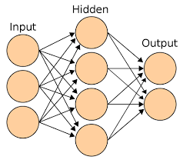
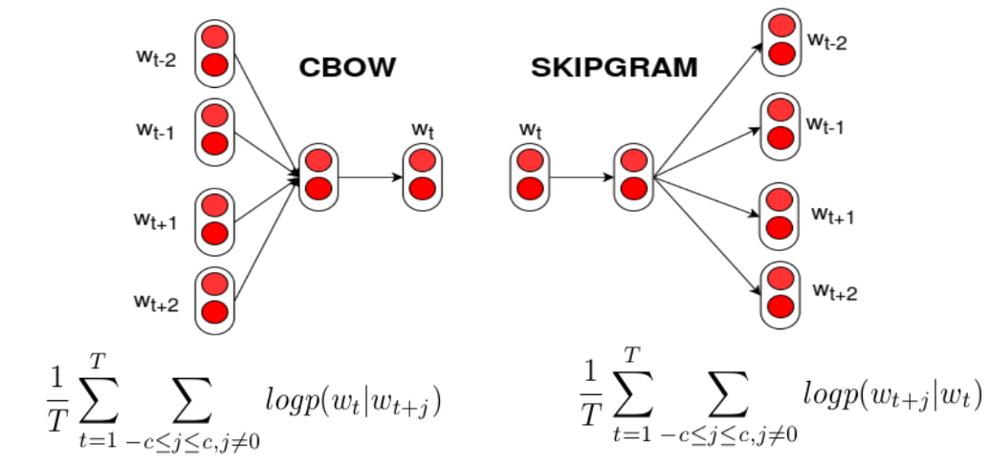
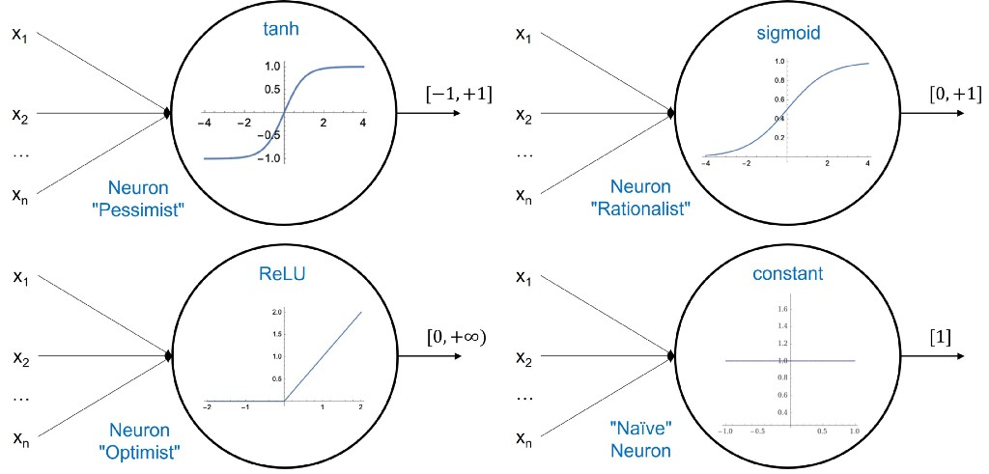
Multi-Layer Perceptron (MLP) on Sentiment Analysis
PyTorch Task:
Input: Natural Language Processing: (sentence, positive/negative) data points.
Learning Weight W: high dimensional tensor
2-Layer MLP.
Activation Function (Linear -> Non-Linear)
Word Representation: Word2Vec/ Glove.
Loss function: Cross Entropy Loss
Gradient Descent Optimizer → Adam Optimizer.
GPU.

Slide 6
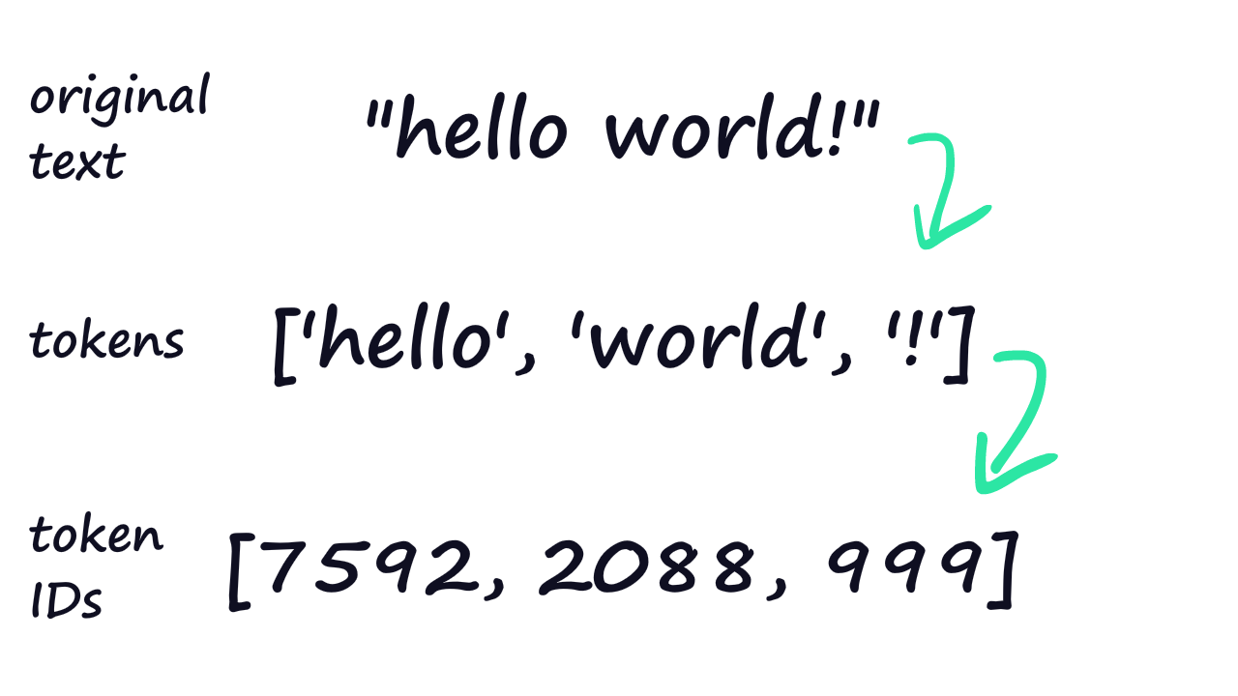
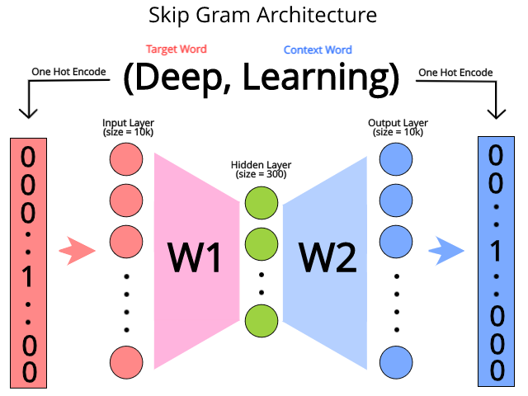
Multi-Layer Perceptron (MLP) on Sentiment Analysis
PyTorch Task:
Input: Natural Language Processing: (sentence, positive/negative) data points.
Learning Weight W: high dimensional tensor
2-Layer MLP.
Activation Function (Linear -> Non-Linear)
Word Representation: Word2Vec/Glove.
Loss function: Cross Entropy Loss
Gradient Descent Optimizer → Adam Optimizer.
GPU.

Slide 7

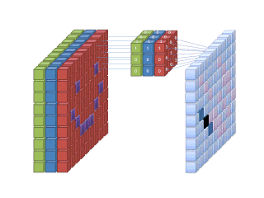
Convolutional Neural Network on Sentiment Analysis (optional)
PyTorch Task:
Input: Natural Language Processing: (sentence, positive/negative) data points.
Weight W: large-scale dimensional tensor
Convolutional Neural Network.
Activation Function (Linear -> Non-Linear)
Dropout.
Loss function: Cross Entropy Loss
Gradient Descent Optimizer → Adam Optimizer.
GPU.

Slide 8
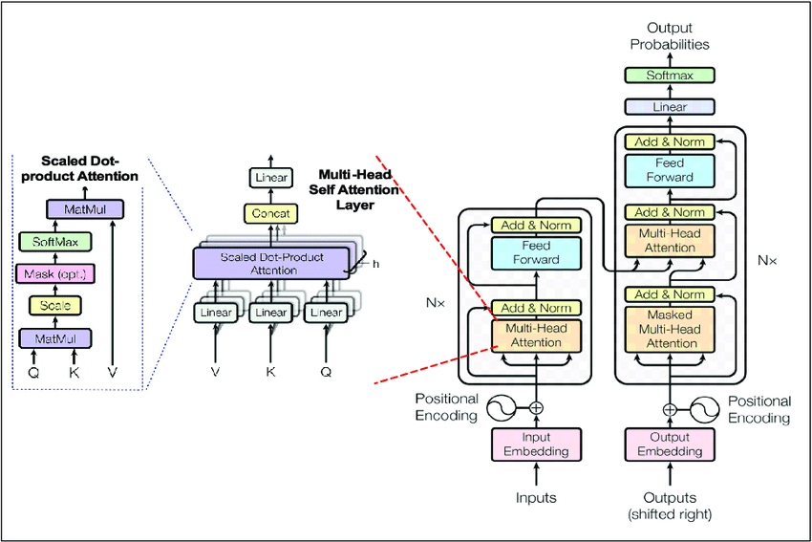

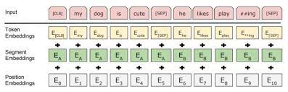
Transformer Architecture on Reading Comprehension
PyTorch Task:
Input: Natural Language Processing: (question, paragraph, answer) Triplet.
Transformer Architecture.
Pretrained-BERT.
Hugging-face Library.
GPU.

Slide 9

Recurrent Neural Network on Sequence Tagging
PyTorch Task:
Input: Natural Language Processing: (sentence, sequence tagging).
Weight W: large-scale dimensional tensor
Recurrent Neural Network.
Activation Function (Linear -> Non-Linear)
Loss function: Cross Entropy Loss
Adam Optimizer.
GPU.

Slide 10
Bag of Word
The bag-of-words (BOW) model: A representation that turns text into fixed-length vectors by counting how many times each word appears. This process is often referred to as vectorization.
For example, Suppose we wanted to vectorize these sentences:
the dog sat
the dog sat in the hat
the dog with the hat
Vocabulary: the, cat, sat, in, hat, and with
Vector: length-6 vectors for each document.
Pros: Easy to implement.
We know what words occurred in the document.
 | the | dog | sat | in | hat | with
the dog sat. | 1 | 1 | 1 | 0 | 0 | 0
the dog sat in the hat | 2 | 1 | 1 | 1 | 1 | 0
the dog with the hat | 2 | 1 | 0 | 0 | 1 | 1
Cons 1: Lose contextual information.
Why: We don’t know where words occurred in the document.
Cons 2: Vector size is the vocabulary size!
6 dim → 100,000 dim?

Slide 11
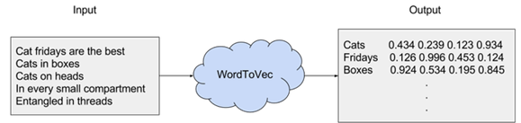
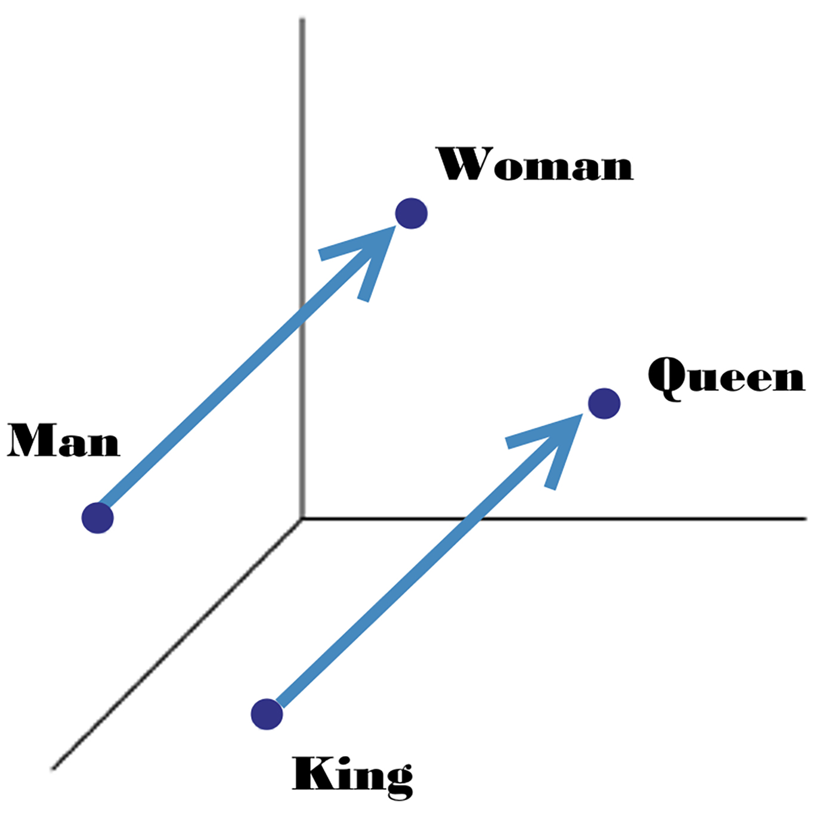
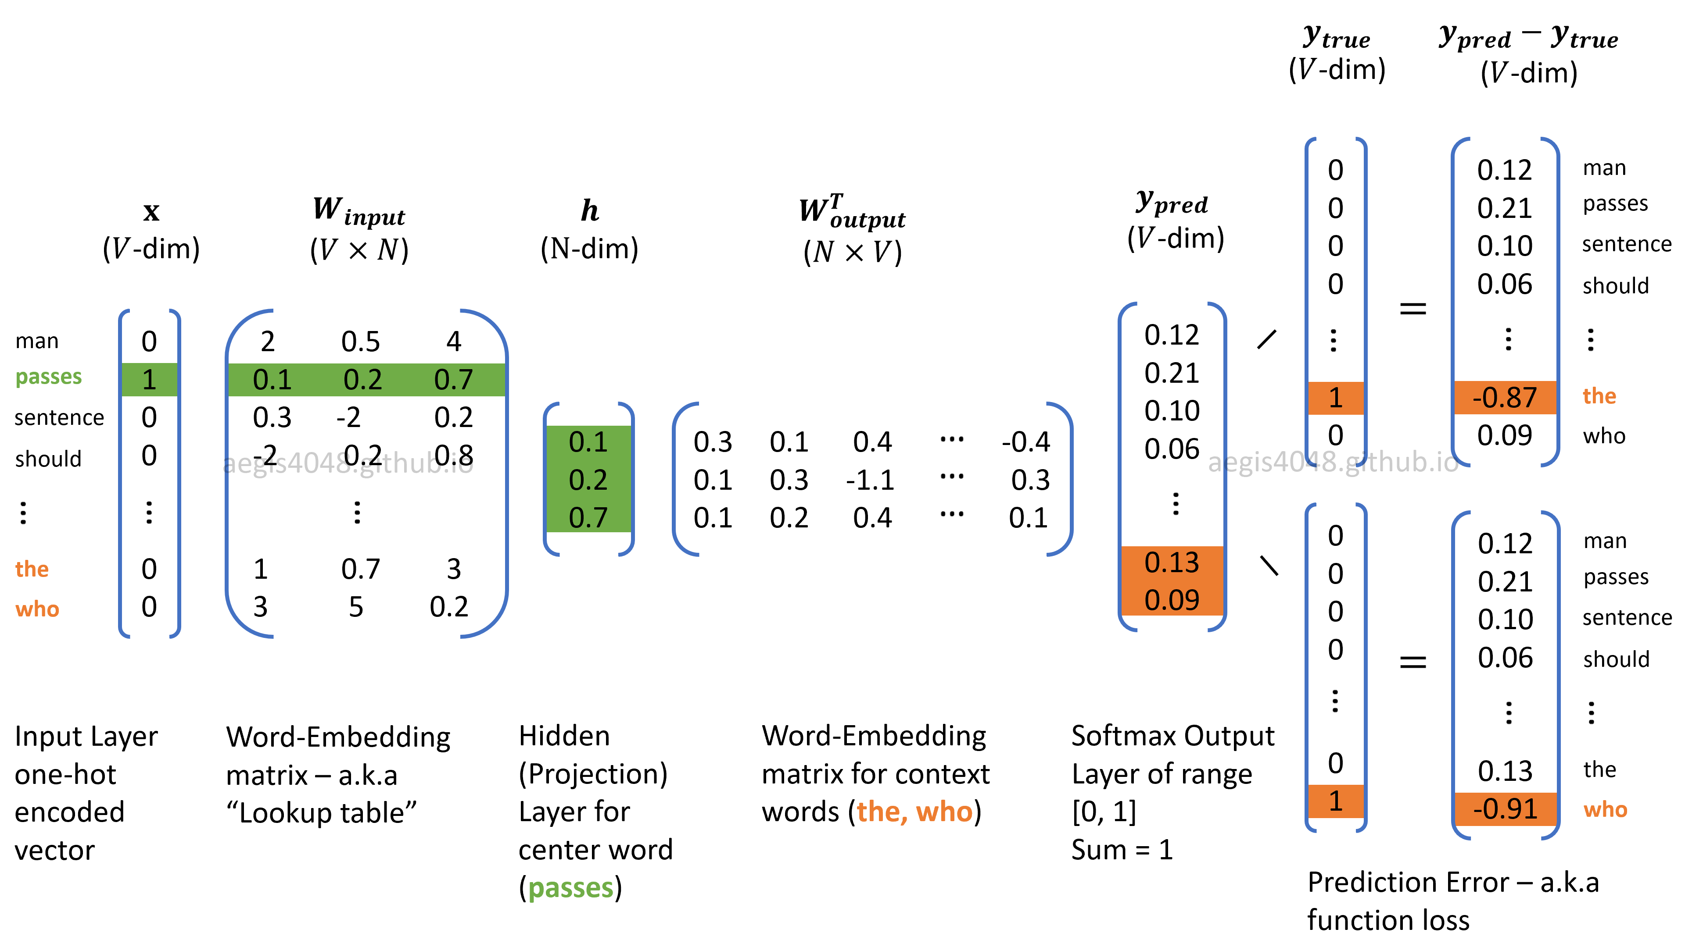
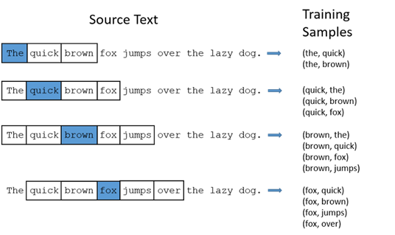
Word2Vec
Word2Vec: A method to build tokens to embeddings.
It can be obtained using two methods (both involving Neural Networks):
Skip Gram.
CBOW.
Split source text to many windows:
E.g. : window size = 2
Negative Sampling: aims at maximizing the similarity of the words in the same context and minimizing it when they occur in different contexts.
Randomly selects several words that not appear in the same context as negative sample.
Positive: The quick brown fox jumps
Negative 1: The deep brown fox jumps
Negative 2: The quick brown learning jumps
…
Great Tutorial in theory and example:https://aegis4048.github.io/demystifying_neural_network_in_skip_gram_language_modeling

Slide 12
Thank you!

